Slide 1
VP160 Recitation Class 8
by Li Chunchao
2016/7/26

Slide 2
Short Review

Slide 3

Rigid body
Angular momentum
Torque
Central force
Moment of inertia for a particle about a point
Conservation of angular momentum
Work and Power in the rotational motion

Slide 4
Precession
Precession

Slide 5
Solving Problems

Slide 6
Rigid body
Two cylinder with same radius R. One is solid. The other one has a hollow with radius r at the center of the cylinder. The hollow is full of liquid with the same density of cylinder. Both cylinder are rotating down a same slope. There are no sliding for both cylinder. Which one will rotate faster? Why?

Slide 7
Rigid body
There is a stick with mass m on the table. A mud with mass m hit on one end of the stick with speed v. Find out which point on the stick is static at the moment just after the mud hit the stick. The length of the stick is L.

Slide 8
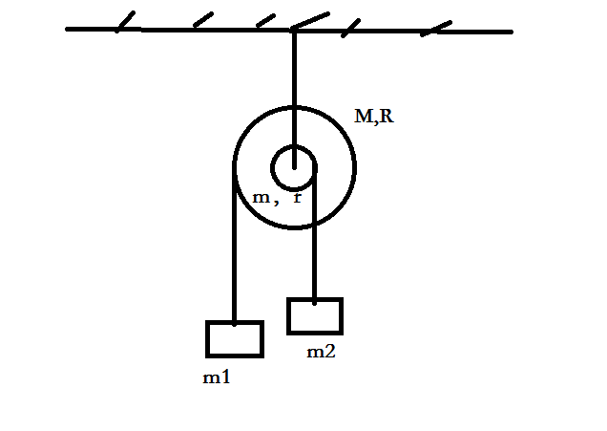
Rigid body
Find the acceleration of m1

Slide 9
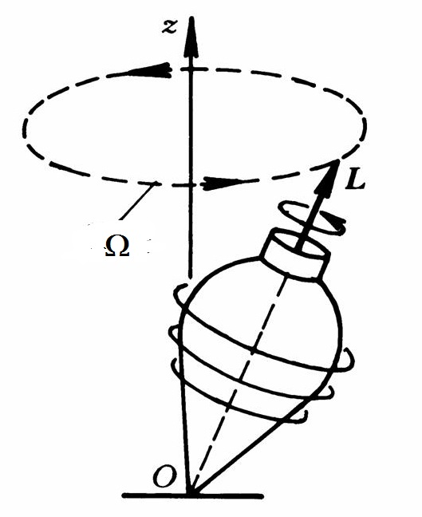
Rigid body
Known angular momentum L, angle between vertical direction and rotating axis θ and mass m. Find angular acceleration 𝛀. The distance between center of mass and origin is d.

